Slide 1

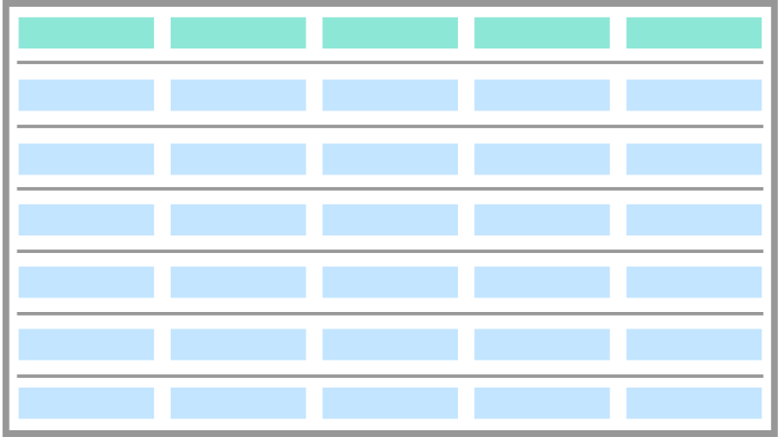

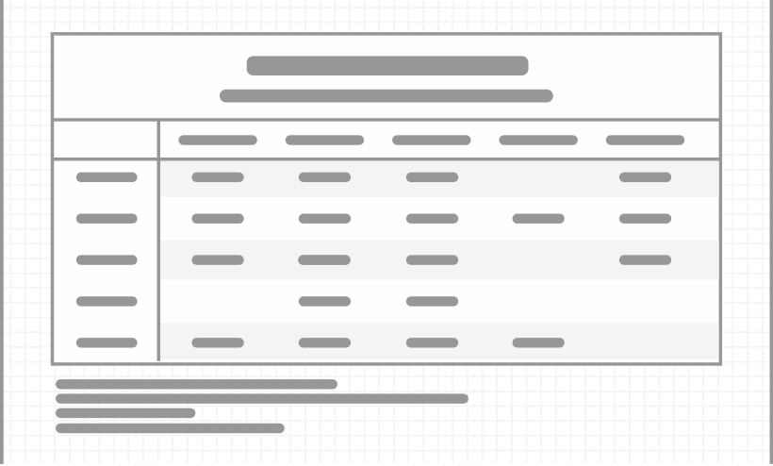



An Introduction to the gt Package
table data
gt object
gt table
rich-iannone
@riannone
rich@rstudio.com

Slide 2
The Typical Workflow for Making Tables with gt
An Introduction to the gt Package
table data
gt object
gt table
The gt package lets us create display tables with a declarative interface, allowing us to fine-tune the final appearance.
Integrate the tables in R Markdown docs and Shiny applications.
Program with gt to make tables as output objects in packages.
Put your data to a form that’s reasonably close to the expected form of the display table.
Use dplyr and tidyr and other great Tidyverse 📦s.

Slide 3
The Typical Workflow for Making Tables with gt
①
②
③
table data
gt object
gt table
Put your data in a form that’s reasonably close to the expected form of the display table.
Use dplyr and tidyr and other great Tidyverse 📦s.
Add table components, group rows together, add spanner labels, footnotes, format cells, add styles…
Output the table to HTML, save an image. RTF and LaTeX output is possible as well.
Use gt’s functions to build. Preview in RStudio.
Use tables in Shiny apps, reports, packages, etc.

Slide 4
The Typical Workflow for Making Tables with gt
①
②
③
table data
gt object
gt table
Put your data in a form that’s reasonably close to the expected form of the display table.
Add table components, group rows together, add spanner labels, footnotes, format cells, add styles…
Use dplyr and tidyr and other great Tidyverse 📦s.
Use gt’s functions to build. Preview in RStudio.
Output the table to HTML, save an image. RTF and LaTeX output is possible as well.
Use tables in Shiny apps, reports, packages, etc.

Slide 5
Categorizing the Useful Features of a Table
The Typical Workflow for Making Tables with gt
①
②
③
table data
gt object
gt table
Put your data in a form that’s reasonably close to the expected form of the display table.
Add table components, group rows together, add spanner labels, footnotes, format cells, add styles…
Output the table to HTML, save an image. RTF and LaTeX output is possible as well.
Use dplyr and tidyr and other great Tidyverse 📦s.
Use gt’s functions to build. Preview in RStudio.
Use tables in Shiny apps, reports, packages, etc.

Slide 6
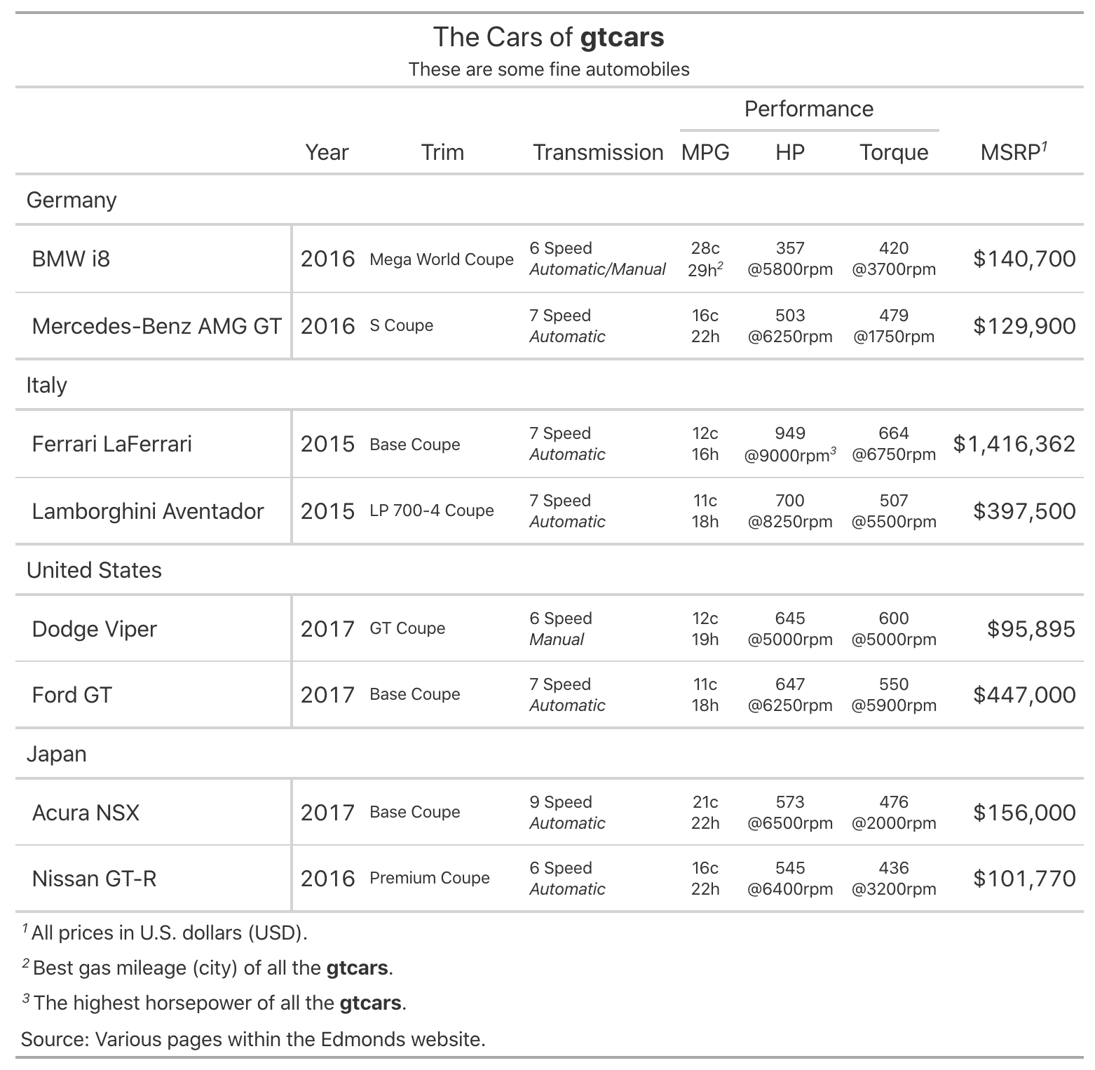
the gt package
Lets you build display tables with easy-to-use functions
Table outputs can be HTML, LaTeX, and RTF
Available on GitHub
The Typical Workflow for Making Tables with gt
Categorizing the Useful Features of a Table
table header
with a title and a subtitle
column labels
along with column spanners
row labels
data formatting
along with row grouping
need to transform raw data for presentation
footnotes
a source note
are in the right order

Slide 7
Categorizing the Useful Features of a Table
We always want the ordering of footnotes to be correct.
1
2
This sort of thing should never have to be done manually.
3
1
2
3
footnotes
are in the right order

Slide 8
Categorizing the Useful Features of a Table
1
To do this right, gt will index the locations left-to-right then
top-to-bottom.
2
All of this ensures that footnotes appear as you might expect.
4
This system also must be smart about the formatting of the footnote marks.
3
5
6
7
8
9
10
11
13
14
15
16
17
18
19
20
21
22
23
24
25
26
27
28
29
30
31
32
33
34
35
36
37
38
39
40
41
42
43
44
45
46
47
48
49
50
51
52
53
54
55
56
57
58
59
60
61
62
63
64
65
66
67
68
69
70
71
72
73
74
75
76
77
78
79
80

Slide 9



To do this right, gt will index the locations left-to-right then
top-to-bottom.
Categorizing the Useful Features of a Table
All of this ensures that footnotes appear as you might expect.
1
2
3

Slide 10
Categorizing the Useful Features of a Table
We can apply the same footnote to multiple locations.
1
1
gt will preserve the same footnote mark
Base coupe
1
2
GT coupe
1
These coupes
3
Multiple footnotes can be applied to the same location.
Base coupe
1,2,3
gt can handle complex footnote marks in a logical manner
GT coupe
1,4,5
1
These coupes can handle
2
Base models tend to
3
This is the only option
4
Although labeled as a
5
Final year in which the
You don’t have to use numerals as footnote marks.
some options:
1,2,3
a,b,c
*,†,††,¶

Slide 11
Categorizing the Useful Features of a Table
We can apply the same footnote to multiple locations.
1
gt will preserve the same footnote mark
Base coupe
1
1
GT coupe
1
These coupes
2
Multiple footnotes can be applied to the same location.
3
Base coupe
1,2,3
gt can handle complex footnote marks in a logical manner
GT coupe
1,4,5
1
These coupes can handle
2
Base models tend to
3
This is the only option
4
Although labeled as a
5
Final year in which the
You don’t have to use numerals as footnote marks.
some options:
1,2,3
a,b,c
*,†,††,¶

Slide 12
The gt Package Formalizes the Parts of a Table
and we can use as many or as few as we need

Slide 13
The Structural Parts of a gt Table
This is the most basic form of a gt table:
stub
head
column
label
stubhead label
column
label
column
label
column labels
cell
row label
cell
cell
cell
row label
cell
cell
stub
table body
cell
row label
cell
cell
cell
row label
cell
cell

Slide 14
The Structural Parts of a gt Table
stub
head
stubhead label
column
label
column
label
column
label
title
column labels
subtitle
row group
row label
cell
cell
cell
row group label
row label
cell
cell
cell
stub
table body
row label
cell
cell
cell
row label
summary cell
cell
cell
summary label
cell
summary cell
summary cell
A table stub is not always needed but it can be useful.
Rows can be grouped, and they can have labels.
Summary rows can be added to groups (or, we can have a grand summary).

Slide 15
The Structural Parts of a gt Table
table
header
title
subtitle
stub
head
stubhead label
column
label
column
label
column
label
column labels
row group
row group label
row label
cell
cell
cell
stub
table body
row label
cell
cell
cell
footnotes
summary label
summary cell
summary cell
summary cell
source notes
A table header is a great place to add a title and a subtitle.

Slide 16
The Structural Parts of a gt Table
table
header
title
subtitle
stub
head
stubhead label
column
label
column
label
column
label
column labels
row group
row group label
row label
cell
cell
cell
stub
table body
row label
cell
cell
cell
summary label
summary cell
summary cell
summary cell
footnotes
table
footer
source notes
Footnotes and source notes serve as useful annotations.

Slide 17
The Structural Parts of a gt Table
table
header
title
Spanner column labels can be used to group columns together.
subtitle
stub
head
spanner column label
spanner column labels
stubhead label
column
label
column
label
column
label
column labels
row group
row group label
row label
cell
cell
cell
stub
table body
row label
cell
cell
cell
summary label
summary cell
summary cell
summary cell
footnotes
table
footer
source notes

Slide 18
The Structural Parts of a gt Table
table
header
title
subtitle
stub
head
spanner column label
spanner column labels
stubhead label
column
label
column
label
column
label
column labels
row group
row group label
row label
cell
cell
cell
stub
table body
row label
cell
cell
cell
summary label
summary cell
summary cell
summary cell
footnotes
table
footer
source notes

Slide 19
table
header
title
subtitle
The Structural Parts of a gt Table
stub
table body
group ‘A’
row group label
row label
cell
cell
cell
spanner column label
spanner column labels
stub
head
stubhead label
row label
cell
cell
cell
column
label
column
label
column
label
column labels
summary label
summary cell
summary cell
summary cell
row group
group ‘B’
row group label
row label
cell
cell
cell
row label
cell
cell
cell
summary label
summary cell
summary cell
summary cell
GRAND
SUMMARY
ROWS
grand summary label
grand summary cell
grand summary cell
grand summary cell
grand summary label
grand summary cell
grand summary cell
grand summary cell
footnotes
table
footer
source notes

Slide 20
The Structural Parts of a gt Table
table
header
title
subtitle
stub
head
spanner column label
spanner column labels
stubhead label
column
label
column
label
column
label
column labels
row group
row group label
row label
cell
cell
cell
stub
table body
row label
cell
cell
cell
summary label
summary cell
summary cell
summary cell
footnotes
table
footer
source notes

Slide 21
Let’s Look at Some of gt’s Functions

Slide 22



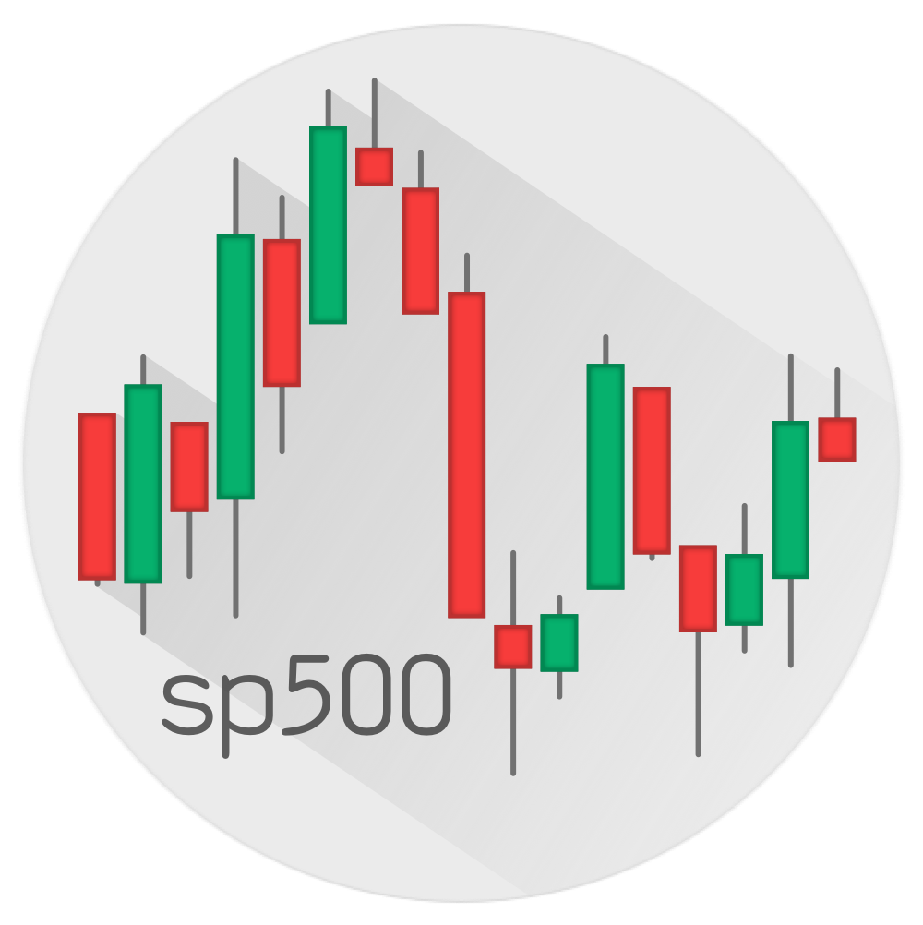


The gt package comes with six example datasets.
They are of various sizes and subject matter. There are some nice examples available at:
countrypops
sza
gtcars
gt.rstudio.com/articles/gt-datasets
Let’s take a look at some examples with exibble: a dataset that’s great for small examples.
sp500
pizzaplace
exibble

Slide 23
The gt package comes with six example datasets.
They are of various sizes and subject matter. There are some nice examples available at:
countrypops
sza
gtcars
12,470 × 5
816 × 4
47 × 15
gt.rstudio.com/articles/gt-datasets
Let’s take a look at some examples with exibble: a dataset that’s great for small examples.
sp500
pizzaplace
exibble
16,607 × 7
49,574 × 7
8 × 9

Slide 24
The First Function You Need to Know
The gt package comes with six example datasets.
They are of various sizes and subject matter. There are some nice examples available at:
gt.rstudio.com/articles/gt-datasets
All of the following examples will use exibble: a dataset that’s great for small examples.
exibble
8 × 9

Slide 25
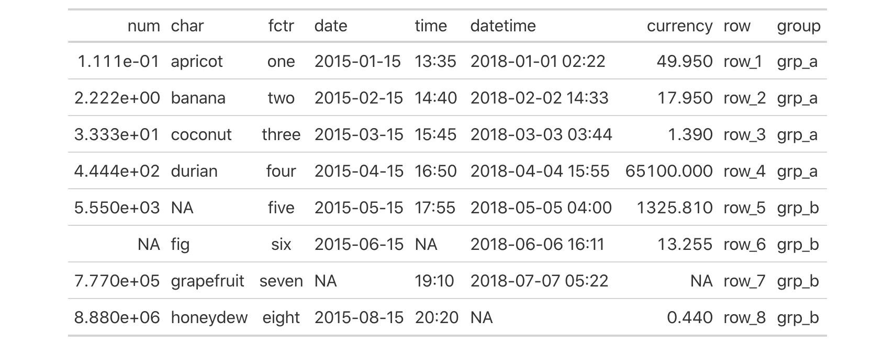
Datasets in gt
Work with Table Components, Add Style
The First Function You Need to Know
Create Table
gt()
CODE
exibble %>% gt()
TABLE

Slide 26
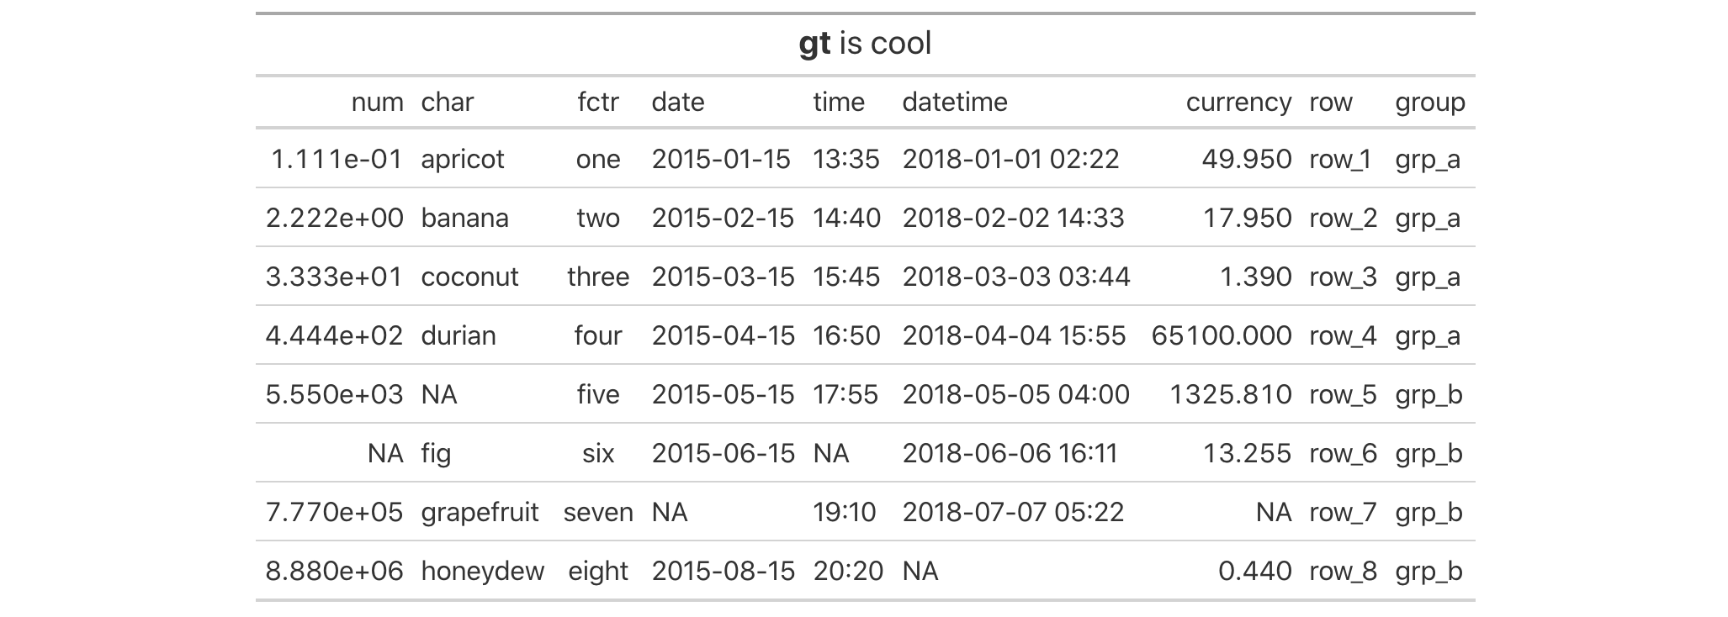
The First Function You Need to Know
Work with Table Components, Add Style
Create or Modify Parts
tab_header() tab_spanner() tab_spanner_delim() tab_row_group() tab_stubhead() tab_footnote() tab_source_note() tab_style() tab_options()
CODE
exibble %>% gt() %>% tab_header(md("**gt** is cool"))
TABLE

Slide 27
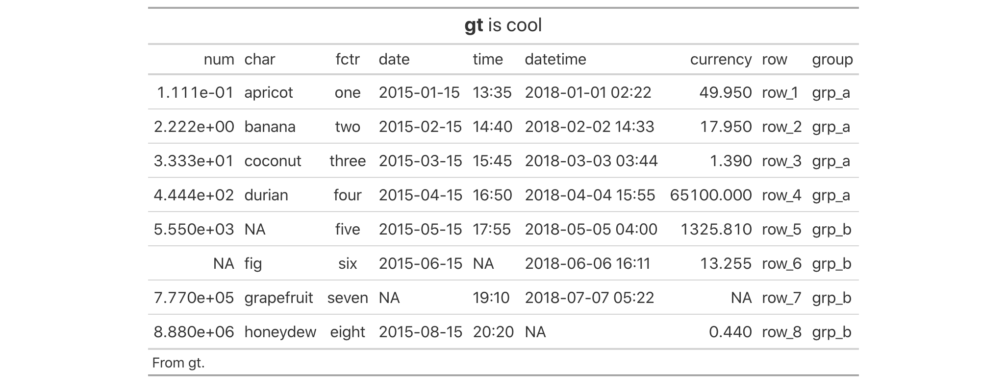
The Formatting Functions
Work with Table Components, Add Style
Create or Modify Parts
tab_header() tab_spanner() tab_spanner_delim() tab_row_group() tab_stubhead() tab_footnote() tab_source_note() tab_style() tab_options()
CODE
exibble %>% gt() %>% tab_header(md("**gt** is cool")) %>% tab_source_note("From gt.")
TABLE

Slide 28
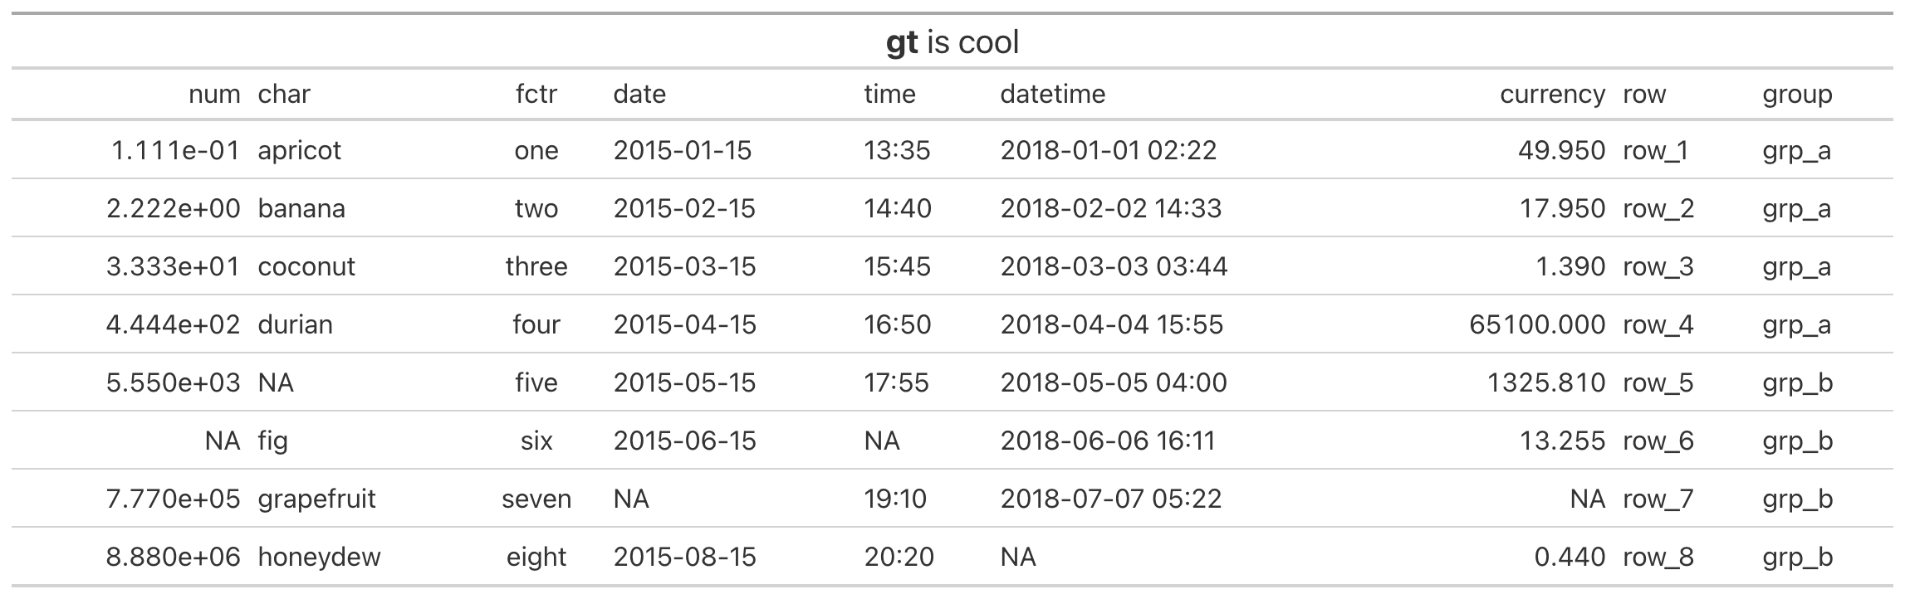
The Formatting Functions
Work with Table Components, Add Style
Create or Modify Parts
tab_header() tab_spanner() tab_spanner_delim() tab_row_group() tab_stubhead() tab_footnote() tab_source_note() tab_style() tab_options()
CODE
exibble %>% gt() %>% tab_header(md("**gt** is cool")) %>%
tab_options(table.width = pct(100))
TABLE

Slide 29
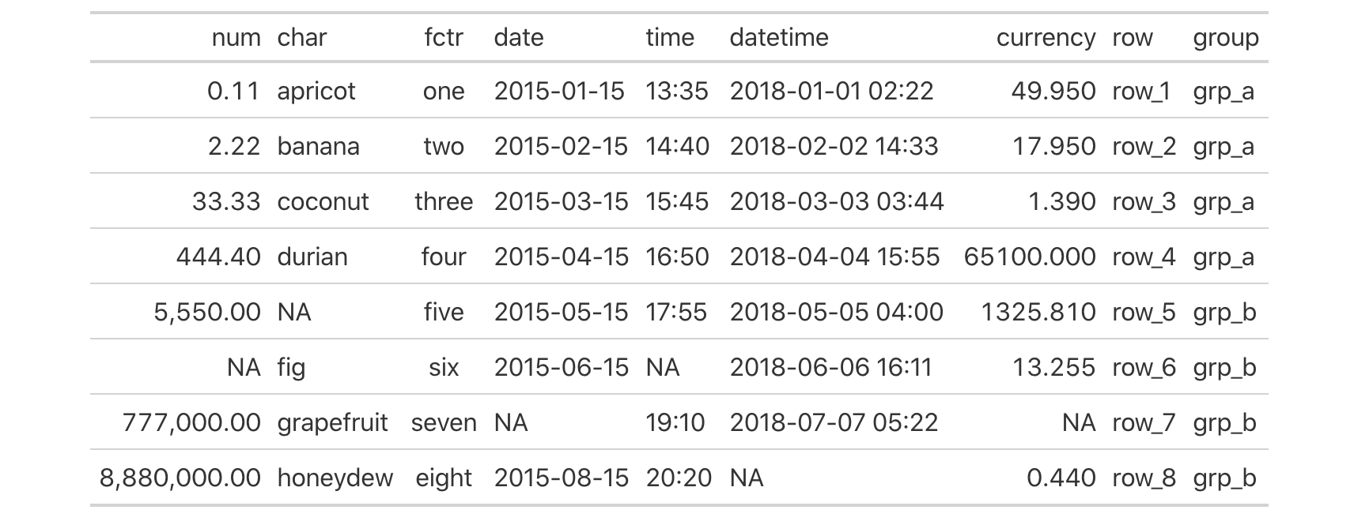
Work with Table Components, Add Style
The Formatting Functions
Format Data
fmt_number() fmt_scientific() fmt_percent() fmt_currency() fmt_date() fmt_time() fmt_datetime() fmt_markdown() fmt_passthrough() fmt_missing() fmt() text_transform() data_color()
CODE
exibble %>% gt() %>% fmt_number(num, decimals = 2)
TABLE

Slide 30
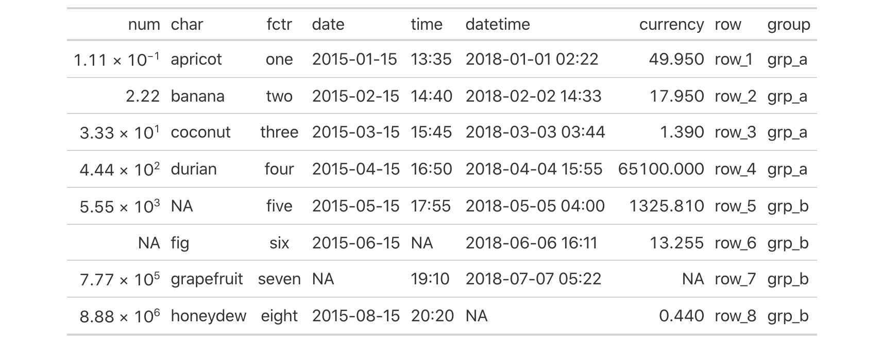
The Formatting Functions
Format Data
fmt_number() fmt_scientific() fmt_percent() fmt_currency() fmt_date() fmt_time() fmt_datetime() fmt_markdown() fmt_passthrough() fmt_missing() fmt() text_transform() data_color()
CODE
)
exibble %>% gt() %>% fmt_scientific(num
TABLE

Slide 31
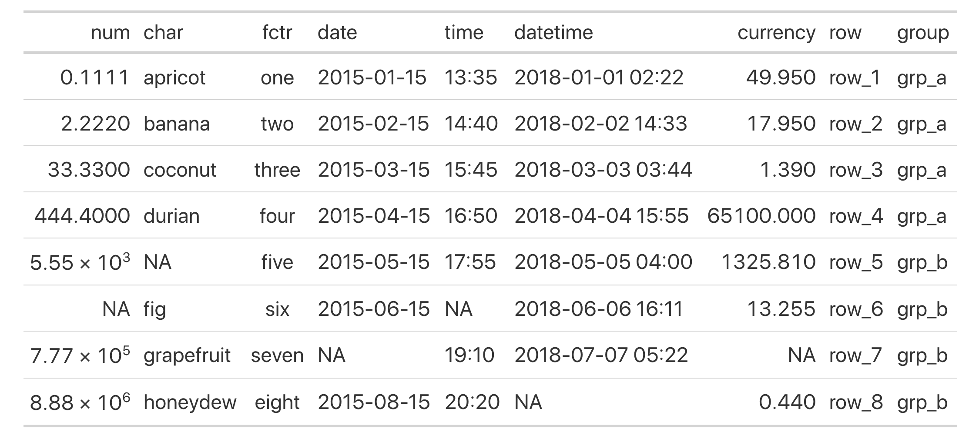
The Formatting Functions
Format Data
fmt_number() fmt_scientific() fmt_percent() fmt_currency() fmt_date() fmt_time() fmt_datetime() fmt_markdown() fmt_passthrough() fmt_missing() fmt() text_transform() data_color()
CODE
)
exibble %>% gt() %>% fmt_scientific(num
, rows = num >= 10^3
TABLE

Slide 32

The Formatting Functions
Format Data
fmt_number() fmt_scientific() fmt_percent() fmt_currency() fmt_date() fmt_time() fmt_datetime() fmt_markdown() fmt_passthrough() fmt_missing() fmt() text_transform() data_color()
CODE
try
info_currencies()
exibble %>% gt() %>% fmt_currency(currency, currency = "EUR")
TABLE

Slide 33
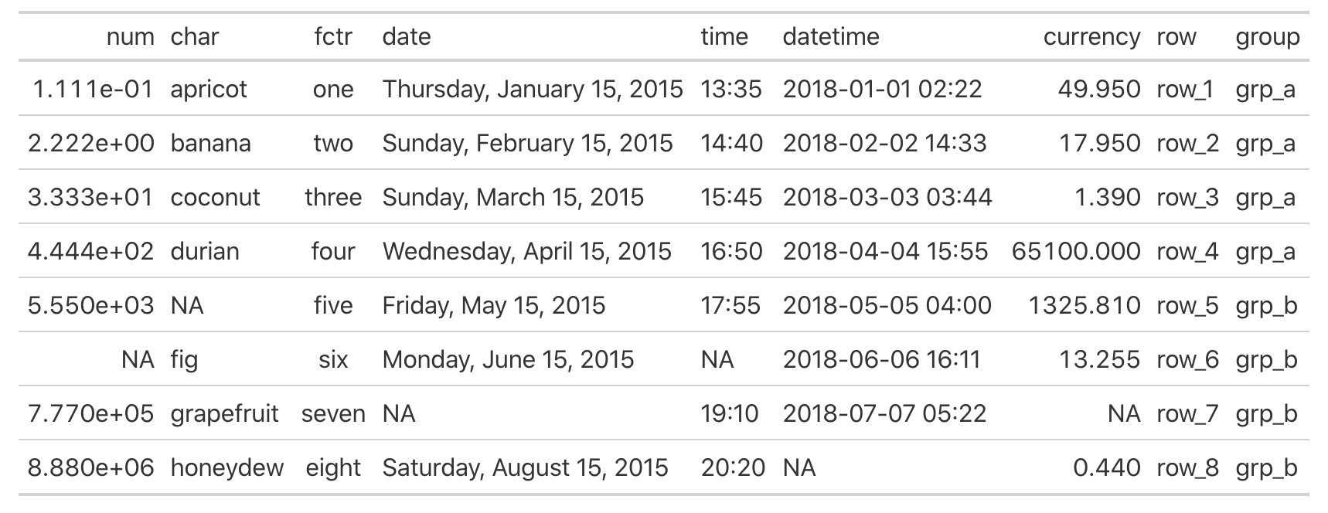
The Formatting Functions
Format Data
fmt_number() fmt_scientific() fmt_percent() fmt_currency() fmt_date() fmt_time() fmt_datetime() fmt_markdown() fmt_passthrough() fmt_missing() fmt() text_transform() data_color()
CODE
try
info_date_style()
exibble %>% gt() %>% fmt_date(date, date_style = 2)
TABLE

Slide 34
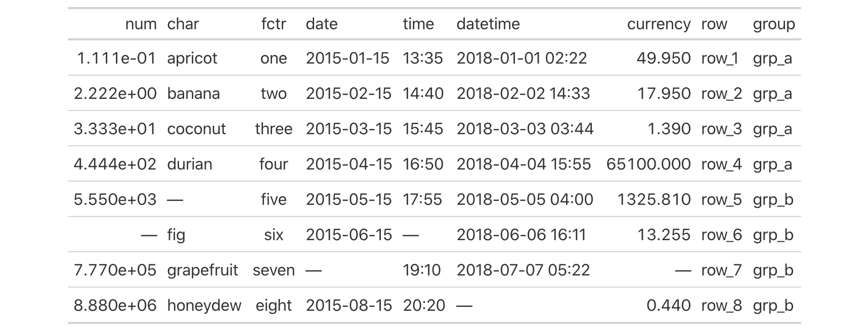
How to Do Modifications on Entire Columns
The Formatting Functions
Format Data
fmt_number() fmt_scientific() fmt_percent() fmt_currency() fmt_date() fmt_time() fmt_datetime() fmt_markdown() fmt_passthrough() fmt_missing() fmt() text_transform() data_color()
CODE
exibble %>% gt() %>% fmt_missing(columns = everything())
TABLE

Slide 35
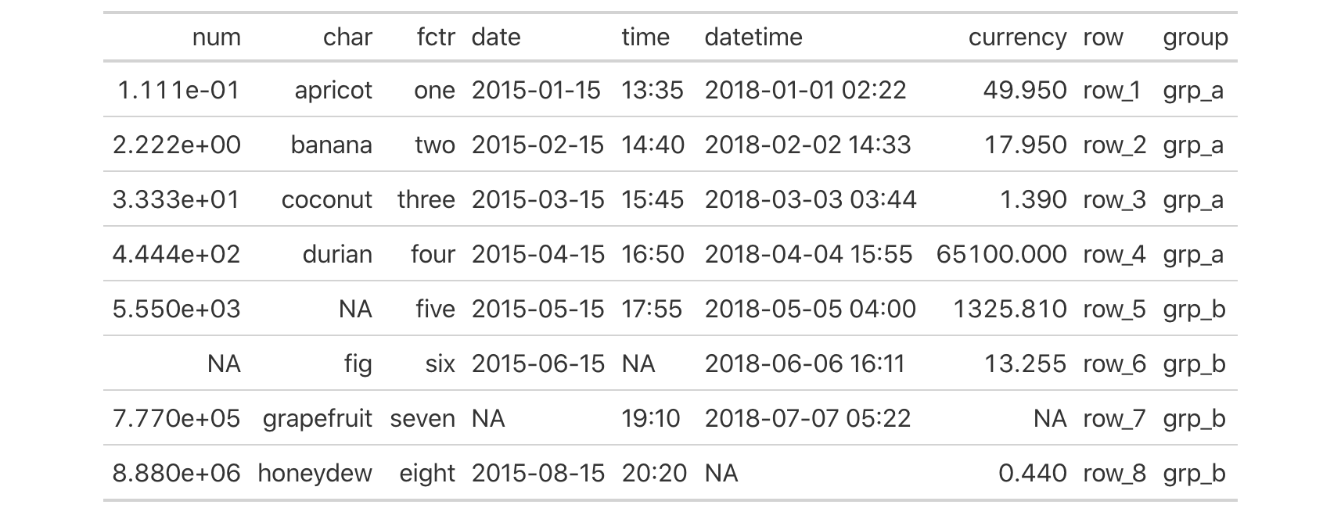
The Formatting Functions
How to Do Modifications on Entire Columns
Modify Columns
cols_align() cols_width() cols_label() cols_move_to_start() cols_move_to_end() cols_move() cols_hide() cols_merge_range() cols_merge_uncert() cols_merge()
CODE
exibble %>% gt() %>% cols_align(c(char, fctr), align = "right")
TABLE

Slide 36
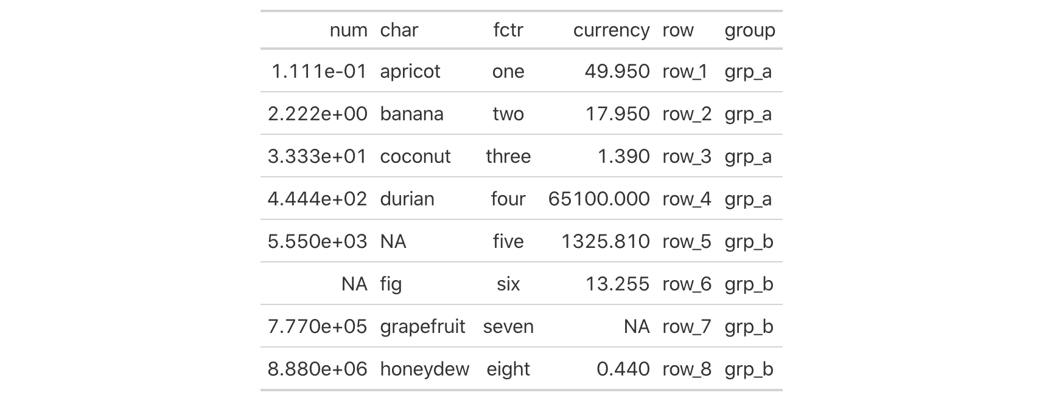
How to Do Modifications on Entire Columns
Modify Columns
cols_align() cols_width() cols_label() cols_move_to_start() cols_move_to_end() cols_move() cols_hide() cols_merge_range() cols_merge_uncert() cols_merge()
CODE
exibble %>% gt() %>% cols_hide(matches("date|time"))
TABLE

Slide 37
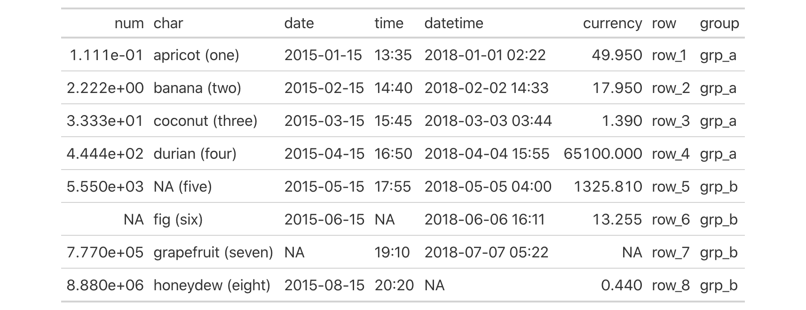
More Functions
How to Do Modifications on Entire Columns
Modify Columns
Create Table
Create or Modify Parts
cols_align() cols_width() cols_label() cols_move_to_start() cols_move_to_end() cols_move() cols_hide() cols_merge_range() cols_merge_uncert() cols_merge()
Format Data
CODE
Modify Columns
exibble %>% gt() %>% cols_merge(columns = c(char, fctr), pattern = "{1} ({2})")
Modify Rows
Add Rows
TABLE
Helper Functions
Image Addition Functions
Table Option Functions
Information Functions
Datasets
Shiny Functions
Export Functions

Slide 38


How to Do Modifications on Entire Columns
More Functions
Create Table
Create or Modify Parts
There is a lot of useful information about each function in gt’s Function Reference section
cols_align() cols_width() cols_label() cols_move_to_start() cols_move_to_end() cols_move() cols_hide() cols_merge_range() cols_merge_uncert() cols_merge()
Format Data
Modify Columns
gt.rstudio.com/reference
Modify Rows
Add Rows
You can try out dozens of examples in RStudio Cloud
Helper Functions
Image Addition Functions
Table Option Functions
Information Functions
The link is available in the package README
Datasets
github.com/rstudio/gt
Shiny Functions
Export Functions

Slide 39
Demo

Slide 40
https://github.com/rich-iannone/presentations
rich-iannone
@riannone
rich@rstudio.com

